Slide 1
AA284B Team A
Preliminary Design Review
February 24, 2020
Efaine Chang Rishav Choudhary Bernadette Haig
Walker Kehoe Tom McClure Jeff Robinson
Elida Sorto-Ramos Alec Taraborrelli Wouter Van Gijseghem

Slide 2
Goal
Startup, shutdown, and restart of LOx-GCH₄ engine
Stretch Goals:
Stable combustion (P_{c} oscillation <5% mean)
Measure C* efficiency
Image engine startup and reignition

Slide 3
System-Level Design & Analysis

Slide 4
System Parameters
Oxidizer | Liquid Oxygen
Fuel | Gaseous Methane
Chamber Pressure | 10 bar (~150 psia)
Thrust | 640 N (~144 lbf)
Throat Diameter | 25.4 mm (1 in)
O/F Ratio | 2.5
Ox Mass Flow Rate | 0.1986 kg/s
Fuel Mass Flow Rate | 0.0795 kg/s
Ox Pressurization | Compressed Nitrogen
Nozzle Expansion Ratio | 2.18 (Sea Level Optimal)
Injector | Coaxial Liquid-Centered Swirl (LOx center swirl, Methane annular axial)
Igniter | Gas-Gas Impinging with spark plug ignition
I_{sp} | 230 sec

Slide 5
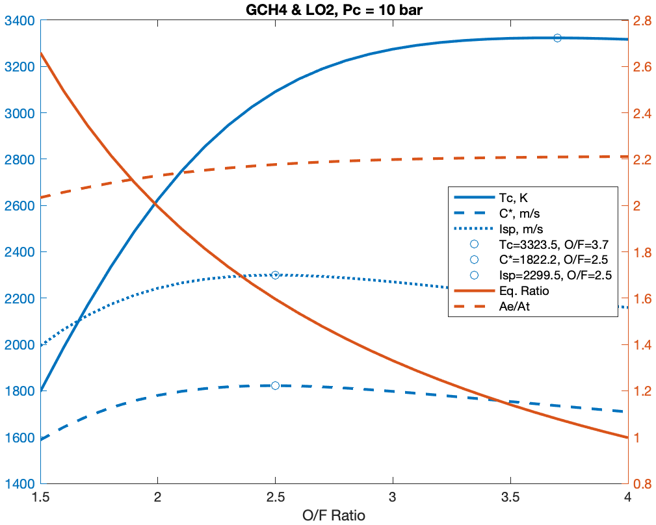
O/F Ratio Survey
CEA Inputs:
CH₄ 298.15 K (25°C)
O₂(L) 90.17 K (boiling)
P_{c} 10 bar
P_{c}/P_{e} 9.87 (P_{e} 1 atm)
Frozen Flow
At O/F 2.5
T_{c} = 3100 K
C*= 1822 m/s
I_{sp} = 2299 m/s (234 s)
Survey repeated for varying chamber pressures

Slide 6
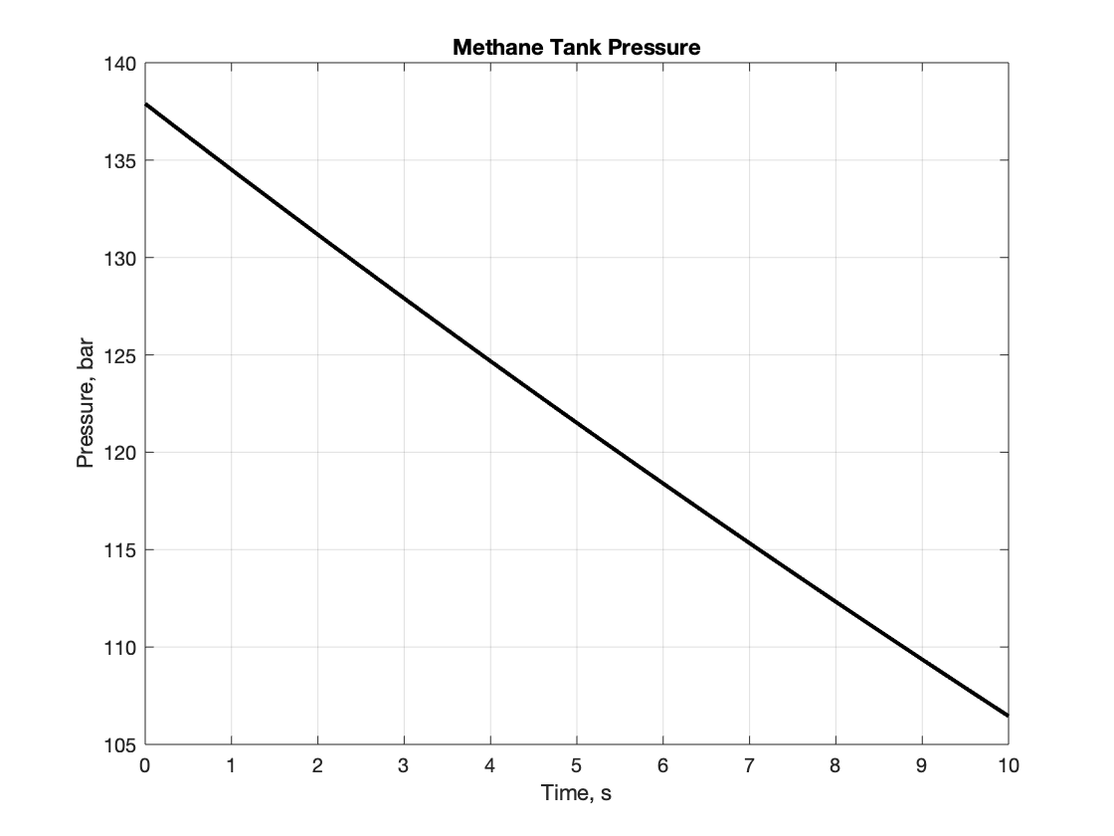
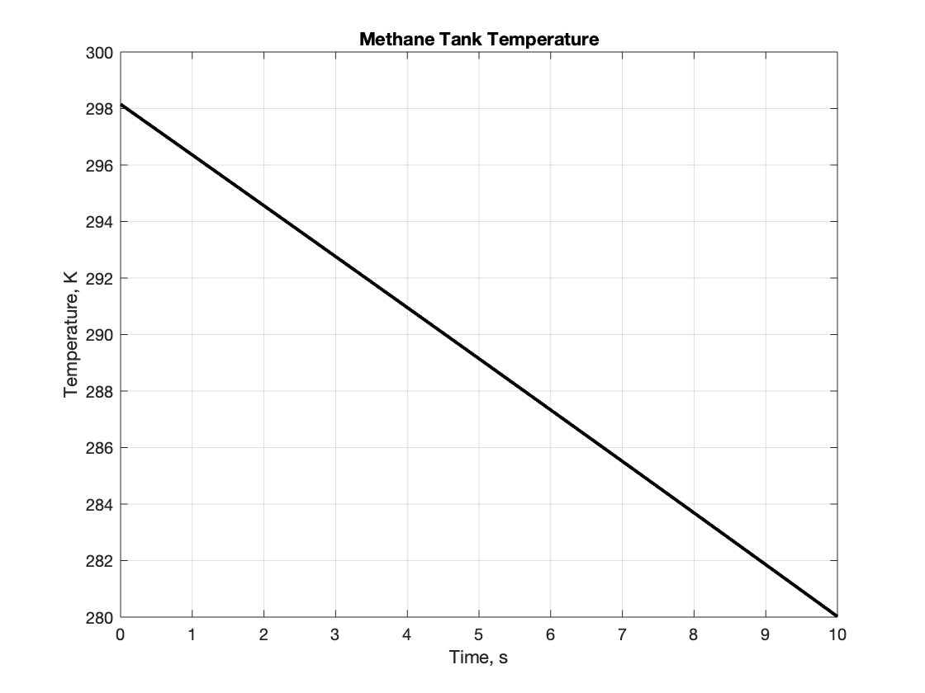
Tank Time Histories - Methane

Slide 7
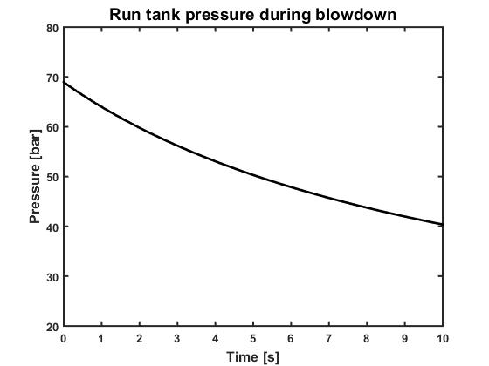
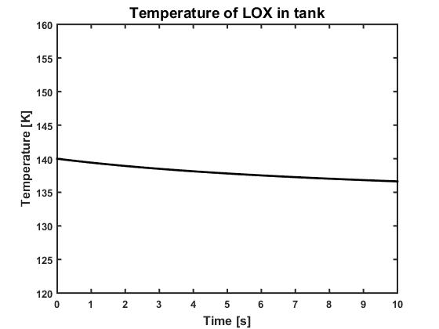
Tank Time Histories - Liquid Oxygen

Slide 8
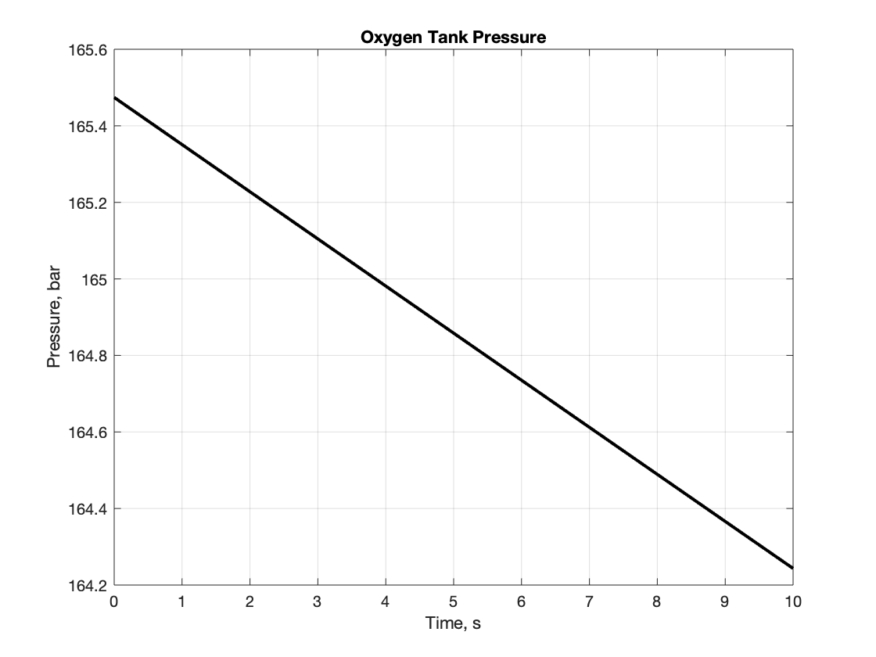
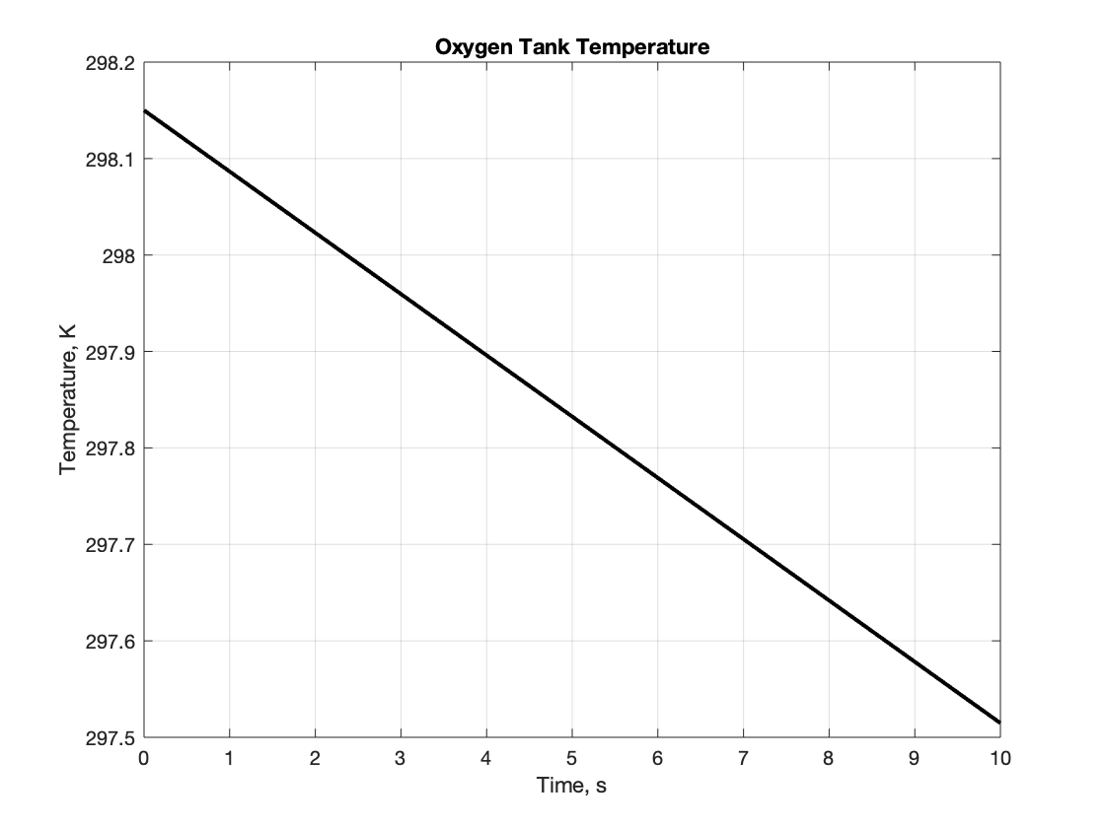
Tank Time Histories - Gaseous Oxygen

Slide 9
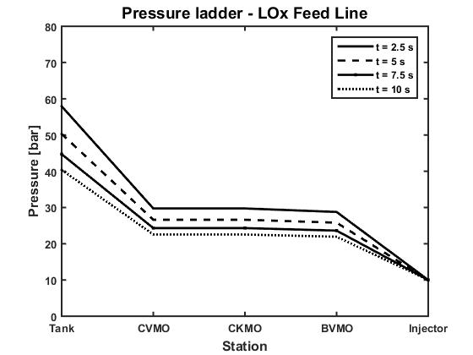
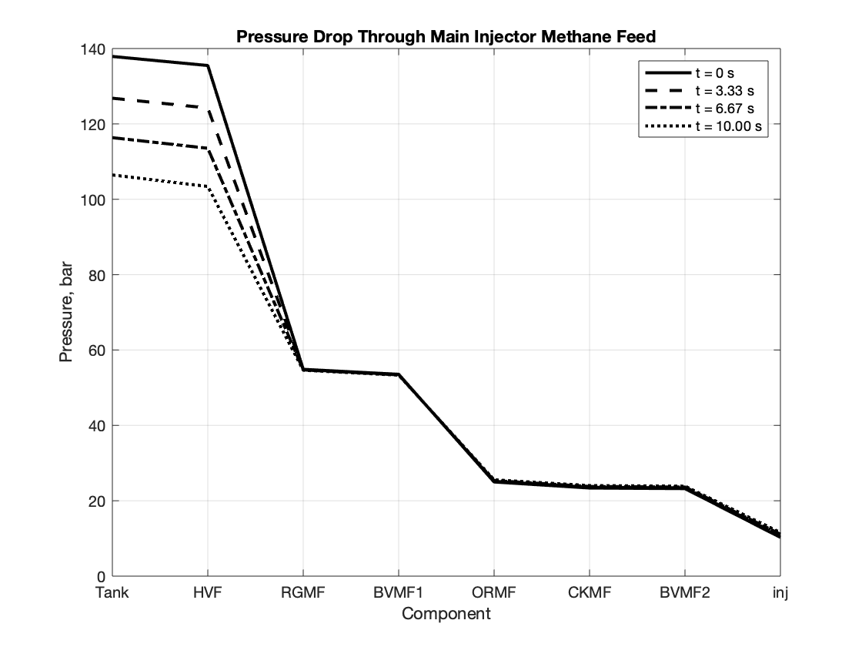
Feed System Pressure Ladder - Main Injector

Slide 10
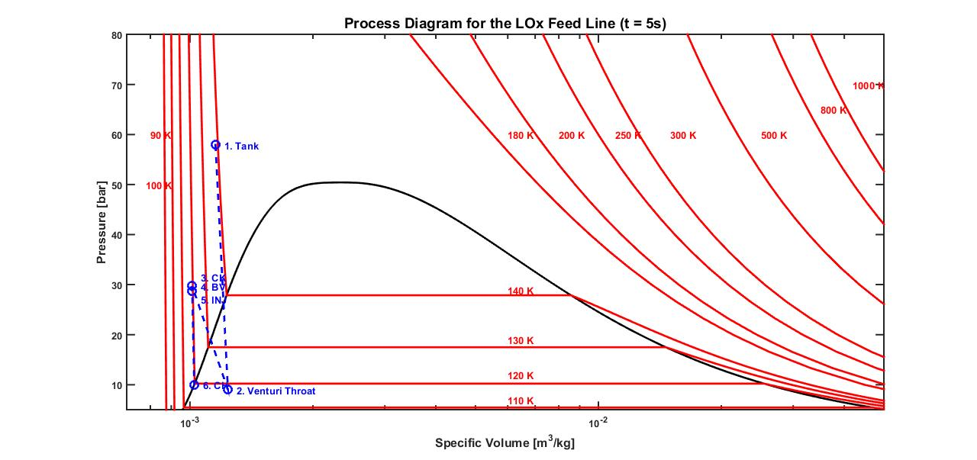
Process Plot - Main Oxidizer Feed

Slide 11
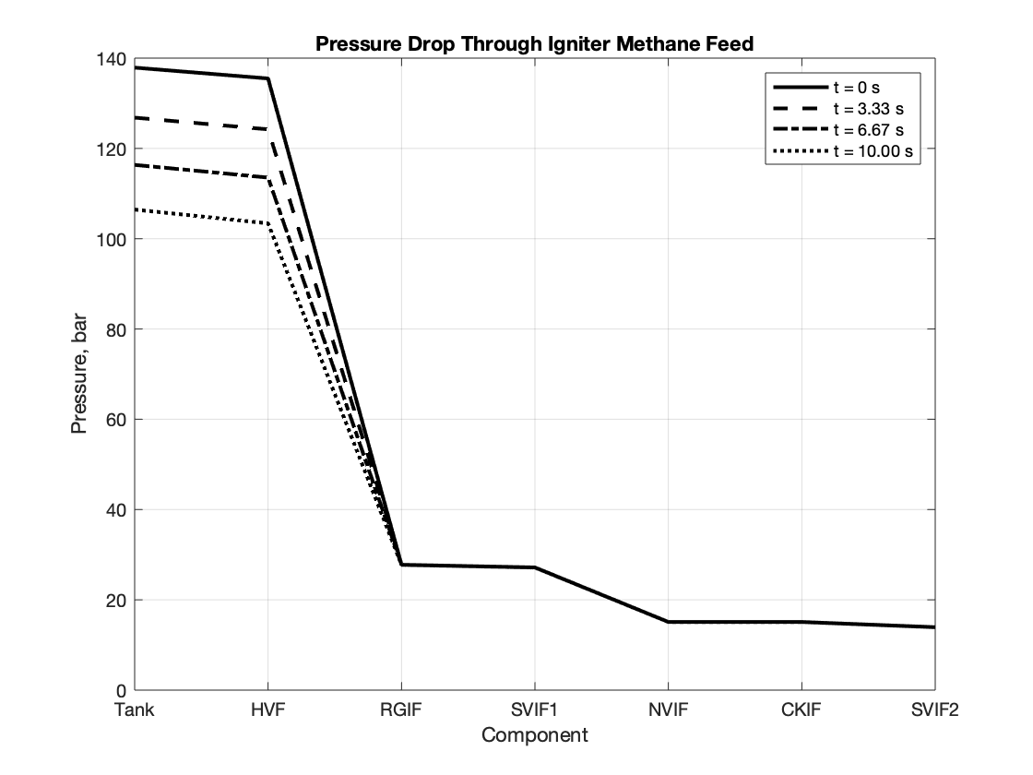
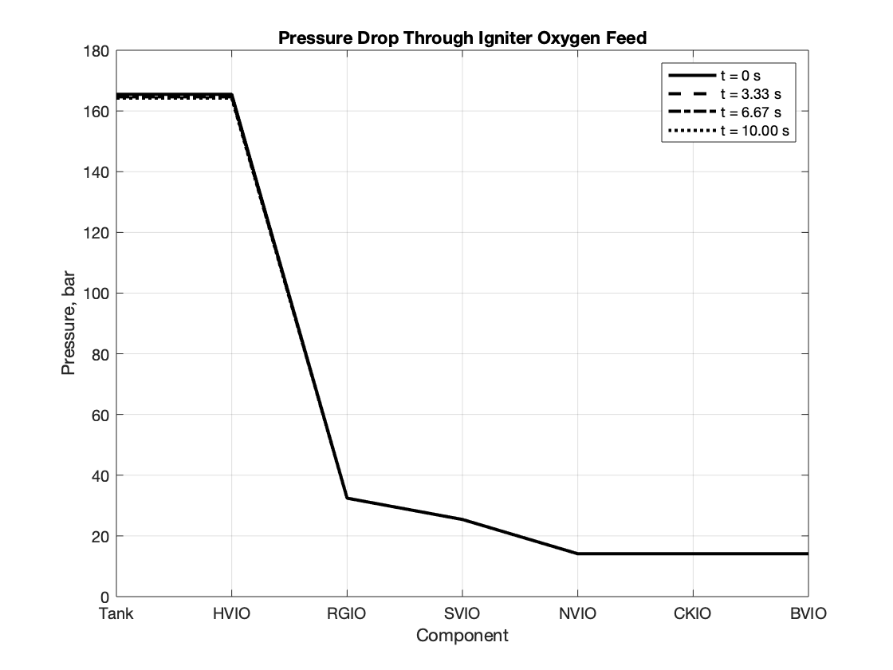
Feed System Pressure Ladder - Igniter
Methane & GOx plots

Slide 12
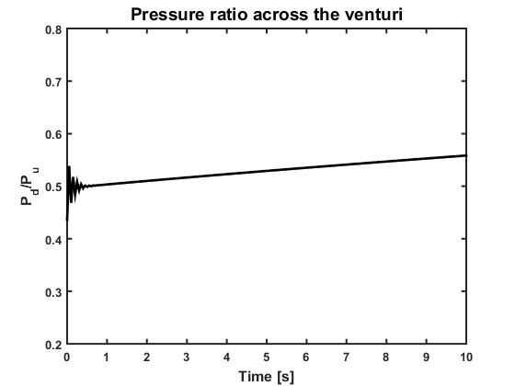
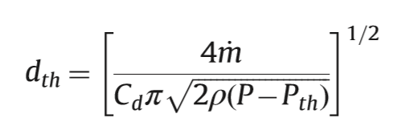
Cavitating Venturi: Pressure Ratio & Design
Designed Specifications
Ox Mass Flow Rate: 0.1986 kg/s
Inlet Pressure: 40 bar
Inlet Temperature: 135 K
Throat Temperature 117K
Cd : ~0.95
Throat Diameter: 2.18 mm

Slide 13
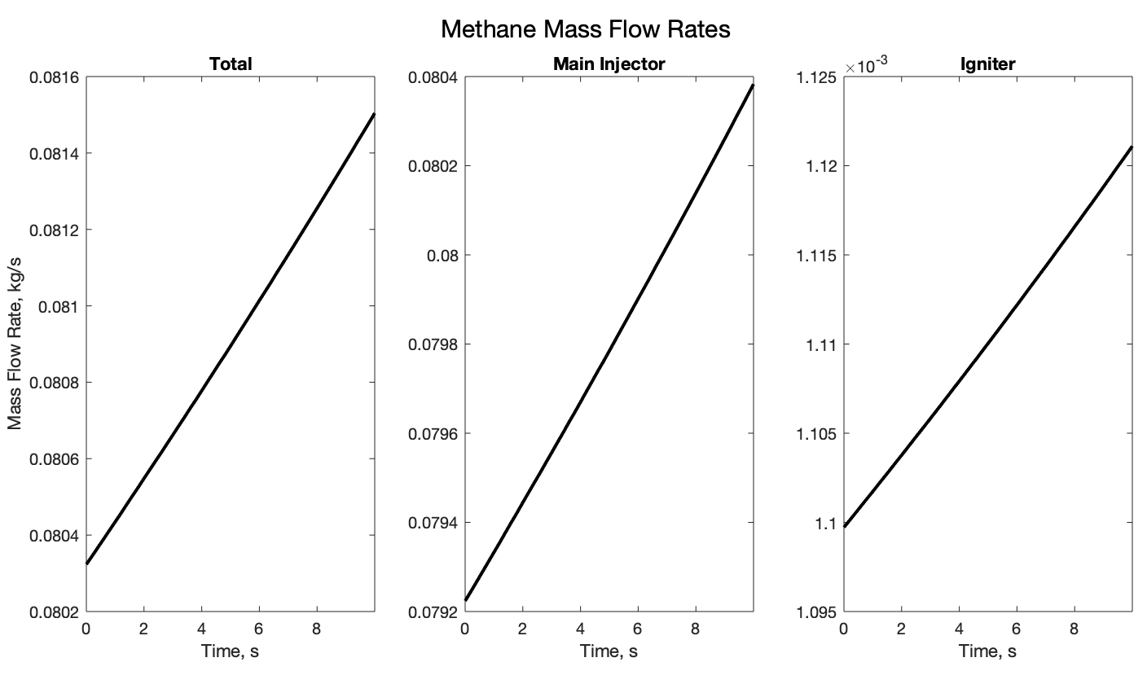
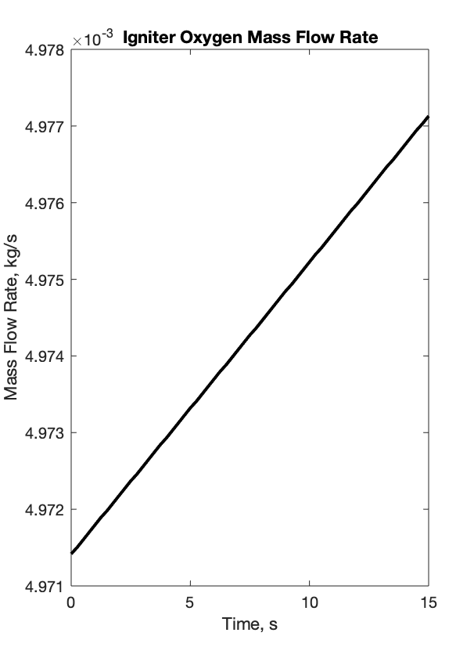
Propellant Mass Flow Rates
Plots until exhaustion
Leftover mass in GOx & Methane after exhaustion

Slide 14
Gas Feed System Sim - Method
Specify simulation parameters
Tank Volume, Temperature & Pressure
Fluid Medium
Time Step
Input system components to parameter table in order of flow
Valve: Cv
Regulator: Cv, Set pressure, droop
Orifice: Cd, Area
Propagate P & T through system with trial mass flow rate
Calculate P from upstream conditions & component parameters (Peng-Robinson EoS for local relations)
Calculate T from P using isothermal, adiabatic, or isentropic correlation (All plots in slides use adiabatic)
Start from low trial mass flow and “sneak up” on choked condition
Asymptotically approaching choked condition allows full definition of P & T downstream of choke
Simultaneous iteration for coupled methane systems
Update tank density using mass flow and time step size
Update tank P & T using isentropic relations & Peng-Robinson Equation of State

Slide 15
Gas Feed System Sim - Temperature Relations
Isentropic: T2 = T1*(P2/P1)^(k/(k-1)) Adiabatic: enthalpy polynomial fit, h(P2, T2)==h(P1, T1)
Tank is modeled as isentropic
Example mass flow differences:
 | Temperature Correlation
System | Isentropic |  | Adiabatic |  | Isothermal
Main Injector CH4 | 0.079495 kg/s | 100% (def) | 0.072554 kg/s | 91.3% | 0.068943 kg/s | 86.7%
Igniter CH4 | 0.001102 kg/s |  | 0.000978 kg/s | 88.7% | 0.000925 kg/s | 83.9%
Igniter GO2 | 0.004962 kg/s |  | 0.004318 kg/s | 87.0% | 0.004129 kg/s | 83.2%

Slide 16
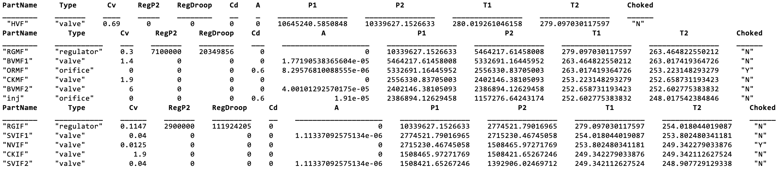
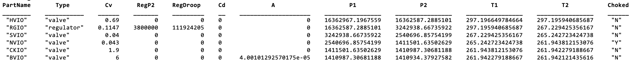
Gas Feed System Sim - Output
Methane System Table (After Simulation) - Tank Valve, Main Injector, Igniter tables
Igniter Oxygen System Table (After Simulation)

Slide 17
Gas Feed System Sim - Notes
Increase in mass flow over time is due to tank cooling
Temperature upstream of flow control orifice & metering valves decreases, so density increases
Current flow control parameters set design mass flow rate near 5 sec run time
All plots and current parameter studies have been done with adiabatic temperature relation
We believe most realistic for our short run times
Valve & regulator pressure drop use formulas from Swagelok TB MS-06-84-E Rev. 4 (2007)
Regulator droop & choking are hard to characterize
Choking currently defined as Q > Qc, where Qc is defined by choked valve flow rate from Swagelok TB
Droop is found from linear fit of regulator flow chart, with factor of 2 added for conservatism
Orifice pressure drop uses formula from AA284B slides / Fox & McDonald Fluid Mechanics
Orifice Cd assumed to be 0.61 (sharp edged plate) until CFD study is done
Polynomial fits for Adiabatic/Isenthalpic temperature relation found using MATLAB CFTool and enthalpy tables for P & T
Some details are missing from the simulation
Viscous losses & heat transfer
Area changes & frictional losses are not included in current code

Slide 18
Cryo Liquid Feed System Sim
Span (Nitrogen) and Schmidt & Wagner (Oxygen) multi-parameter EOS used for determining thermodynamic fluid properties
Isentropic expansion of Nitrogen to occupy the volume generated by liquid oxygen leaving the run tank
No heat transfer from the surroundings
Heat exchange at the N2/LOx interface ignored
Constraint imposed: Total Volume remains fixed at all time steps
Isenthalpic pressure drop across the valves
For a fixed backpressure, calculate the upstream pressure (till the venturi exit) using known discharge coefficients and mass flow rate from the previous time step
Isentropic expansion from the tank exit to the venturi throat
Cavitation occurs if the state of oxygen at the throat is saturated (inside the vapor dome)
Mass flow at the subsequent time step determined solely by the tank pressure if choked

Slide 19
P&ID and Component List

Slide 20
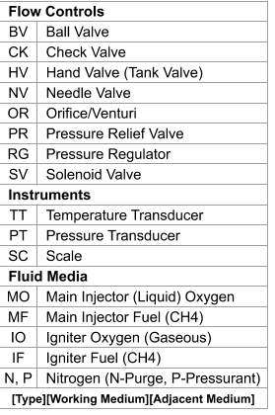
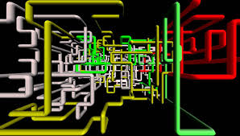
P&ID

Slide 21

P&ID

Slide 22
P&ID Rationale
Downstream on/off valves (BVMO2, BVMF2, BVIO, SVIF2)
Propellant feed control for run prep and start
As close as possible to injector & igniter to minimize slosh volume
Propellant stream check valves (CKMO, CKMF, CKIO, CKIF)
Prevent backflow into propellant tanks
Provide closed purge volume for test abort or post-test safing
Purge check valves (CKPMO, CKPMF, CKPIO, CKPIF)
Prevent propellant flow into purge system before & during test
Prevent backflow in case of anomaly during purge
Flow Rate Controls (ORMO, ORMF, NVIO, NVIF)
Mass flow rate metering via flow choking (cavitation on LOx line)
Vernier handle needle valves for igniter mixture & flow rate tuning

Slide 23
P&ID Rationale
Upstream on/off valves (BVMF1, SVIF1, SVIO)
Propellant shutoff for igniter (after startup) and main injector (test termination)
Close before downstream on/off valves to allow purge
SVMO1 substitutes on LOx line by venting feed pressure
Pressure regulators (RGMF, RGIF, RGIO, RGN)
Maintain steady feed pressure for gas systems to maintain steady mass flow rates through orifices
Hand valves (HVMO, HVF, HVIO, HVN) - Installed on tanks before delivery, included for completeness
LOx System Specifics
BVMO1: Fill control for LOx, to allow full remote control of run tank during chill-in
SC: Load cell for LOx load monitoring
SVMO1: LOx run tank relief & vent - could not find cryo relief valves with set pressure >1000 psi
SVMO2: Line vent for chill-in & safing, to prevent trapped cryo volume

Slide 24
P&ID Rationale
Nitrogen System Specifics
SVP: Remote control for pressurization of LOx run tank
SVN: Remote control of propellant purge
CKPMO: Prevent O2 backflow into inert gas system if vapor pressure rises above Nitrogen feed
Manifold: Split purge feed to different lines
Instrumentation
Propellant lines have P & T measurements to validate operating conditions & settings prior to test
Cavitating venturi ORMO has PTs at inlet & throat to ensure cavitation
Pressure downstream of metering orifices in igniter streams
Ensure choking (compare to regulator set pressure)
Monitor igniter feed conditions closely
Igniter & main chamber pressures
Thrust calculation
Ignition check

Slide 25
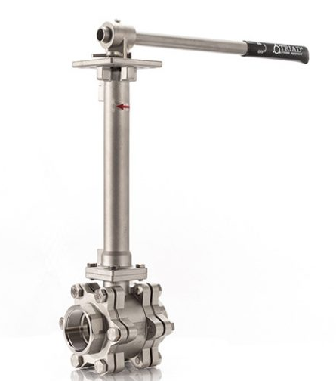
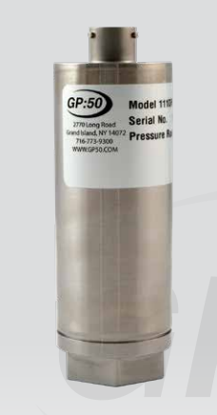
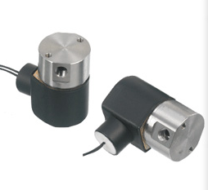
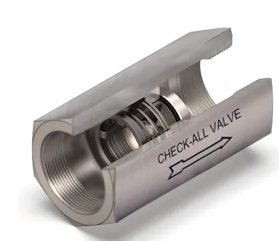
P&ID Key Components
Cv: 0.07
Cv: 19
Cv: 1.9
Cryo Ball Valve Triad 60C - 005 MAWP: 2000 psi Wetted Material: SS 316, PTFE Actuation Torque: 180 in/lbs
Cryo Check Valve Check All U3 Series MAWP: 3000 psi* Wetted Material: SS 316, PTFE Cracking Pressure: 1.5 psi
Solenoid Relief Valve Gems D-Cryo Series MAWP: 1000 psi Wetted Material: Rulon, PTFE, SS 316
Pressure Transducer GP 50-311 C MAWP: 15000 psig Wetted Material: 17-4 SS 6’ stand off from LOX line

Slide 26
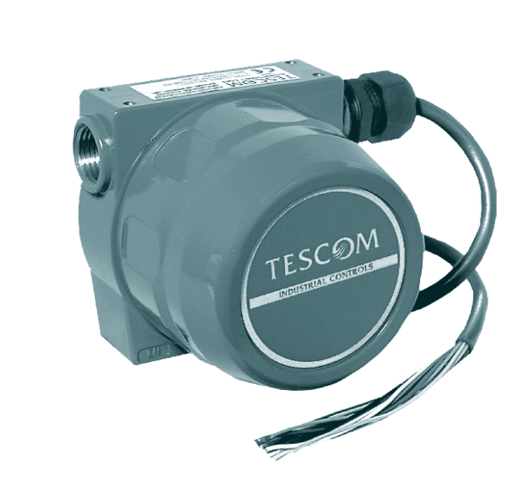
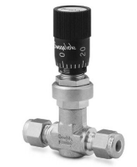
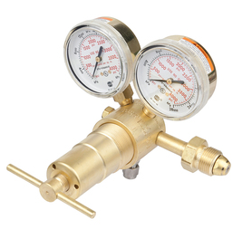
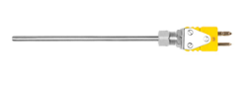
P&ID Key Components
Cv: 0.3
Cv: 0.16
Cv: 0.04
Vernier Needle Valve Swagelock SS 4M & SS 4L MAWP: 2000 psi Wetted Material: SS 316, Fluorocarbon
Tank Regulators* Victor SRJ-4 - Tank Specs MAWP: 3000 psi Wetted Material: Brass, Delrin
Fuel feed Regulator Tescom Pressure Regulator MAWP: 6000 psi Wetted Material: Brass, Viton
RTD Namac A8A-45-6 Min Temp: -270 C

Slide 27
P&ID Fitting Accounting Spreadsheet
https://docs.google.com/spreadsheets/d/1Akb-G0P3gi-R2JIjckR0jrPFSVN0DPMDoXRMupv_SYY/edit?usp=sharing

Slide 28
Component Design

Slide 29
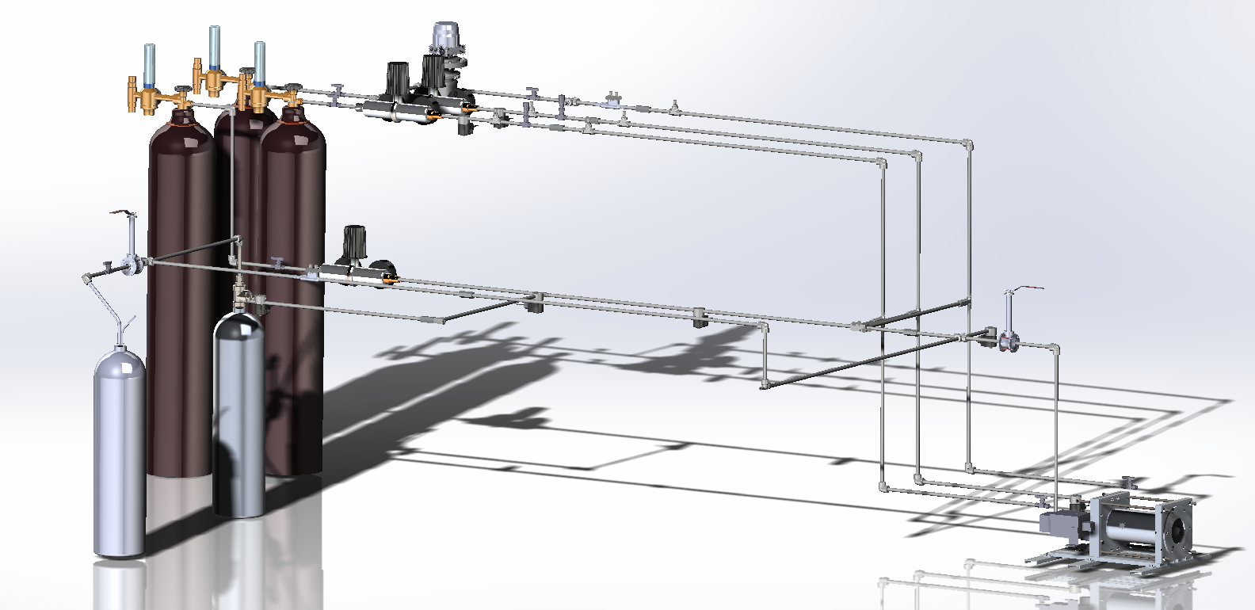
Overall System Layout

Slide 30
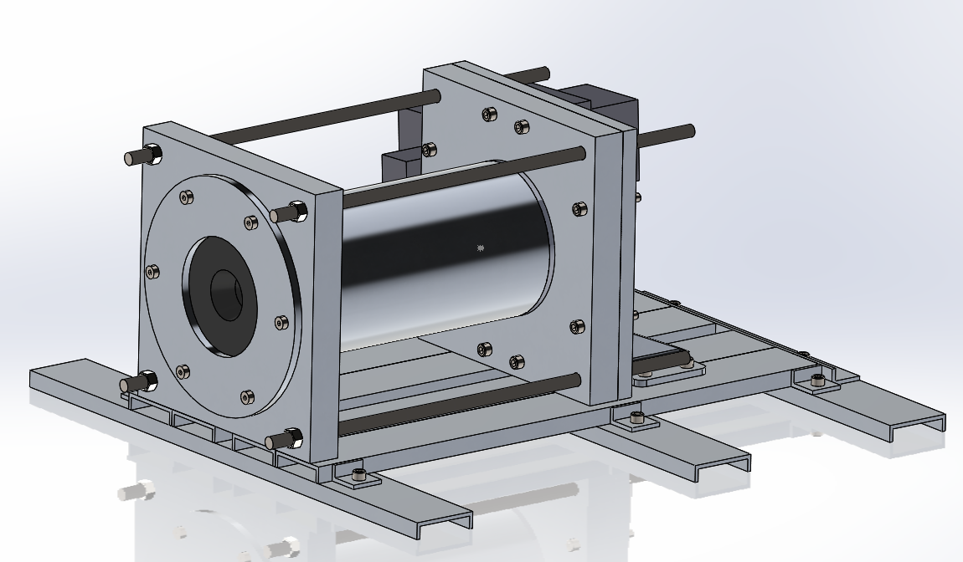
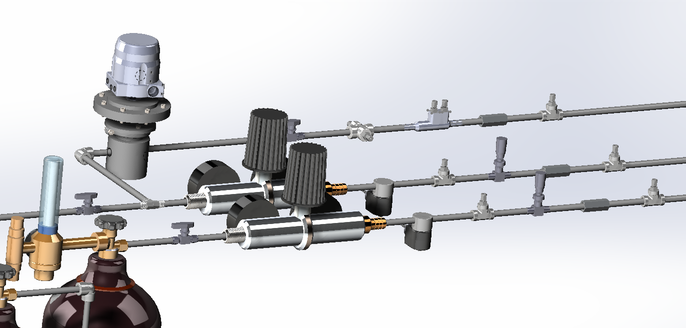
Overall System Layout

Slide 31
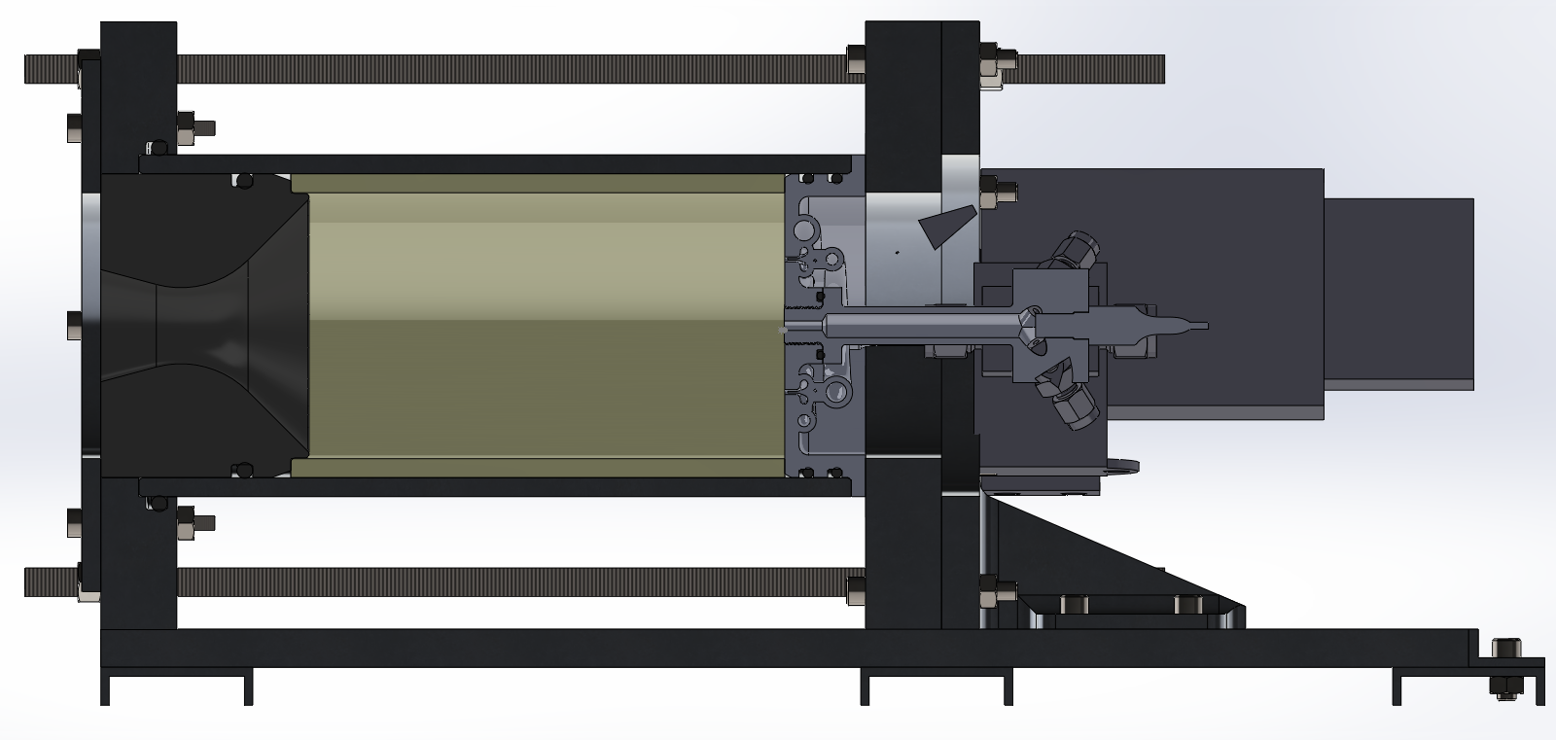
Rocket/Test Stand Integration

Slide 32
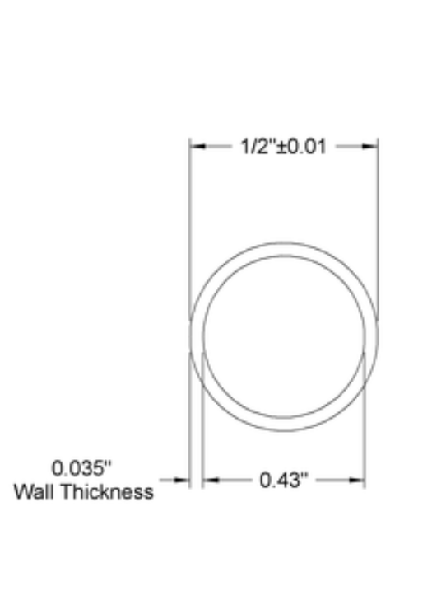
Tube Sizing
SS 316 Welded Tubing
0.5” OD x 0.035” Wall thicknesses
ASTM 213
2.5 Safety Factor on 1000 Psi Working Pressure
Flow Velocity LOX
2.5 m/s
0.3 psi / ft pressure drop in tubing
Flow Velocity GCH4
128 m/s
1.9 psi / ft pressure drop in tubing

Slide 33
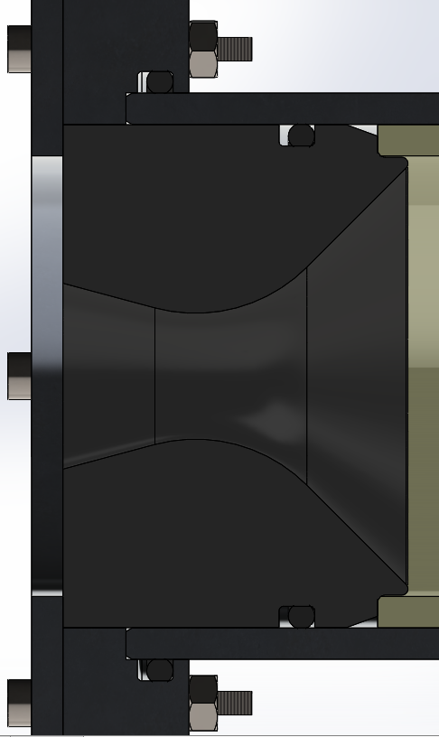
Nozzle
349 O-ring
342 O-ring
Material selection:
Nozzle: High density graphite
Chamber wall, flange and support plate: AL6061-T6
Canvas phenolic
A_{e}/A₀ = 2.18
Standard 15 deg cone
σ_{hoop} = 2502 psi
FS = 16 (designed for 150 psi)
Sealing interfaces:
2 O-rings:
342 size O-ring
349 size O-ring

Slide 34
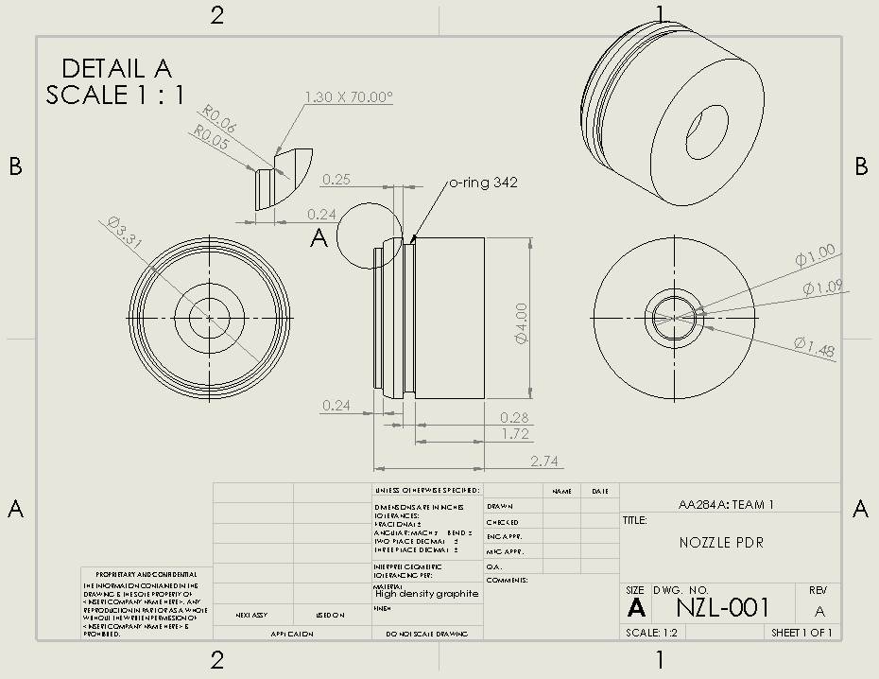
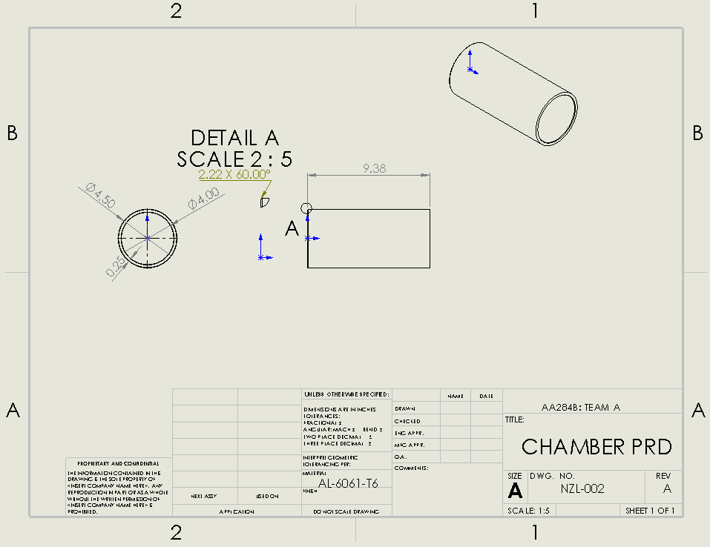
Nozzle

Slide 35
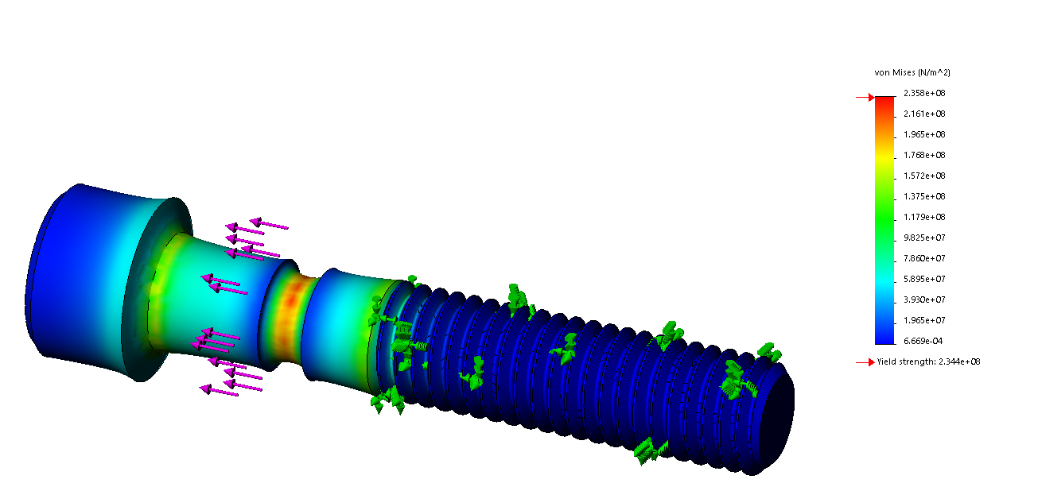
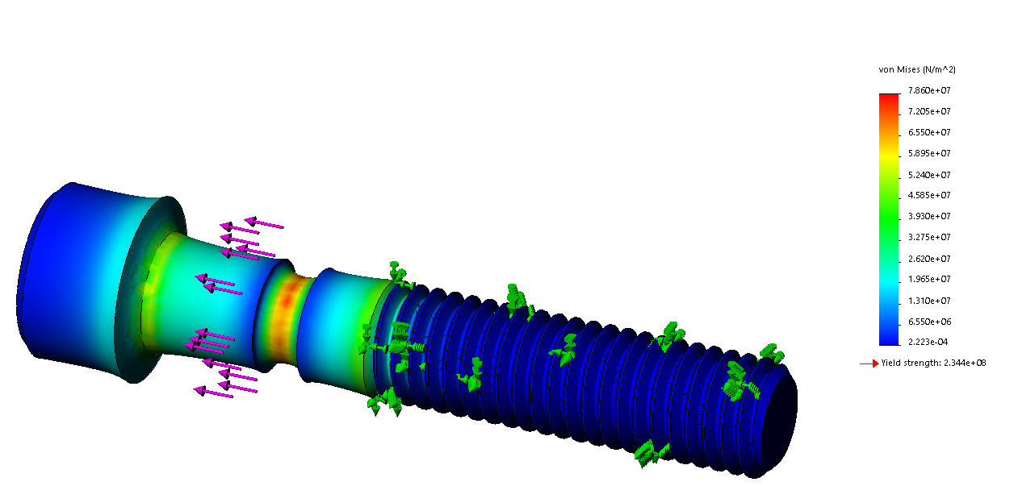
Combustion Chamber Overpressure Relief
Notched design
Designed to fail at 800 psi
Axial force in bolts: 9000 N
Max σ_{von-mises} = 230 MPa
Stainless steel
Cut is 0.06 inch deep
Tool diameter: 0.1 inch
At limit load
At nominal load

Slide 36
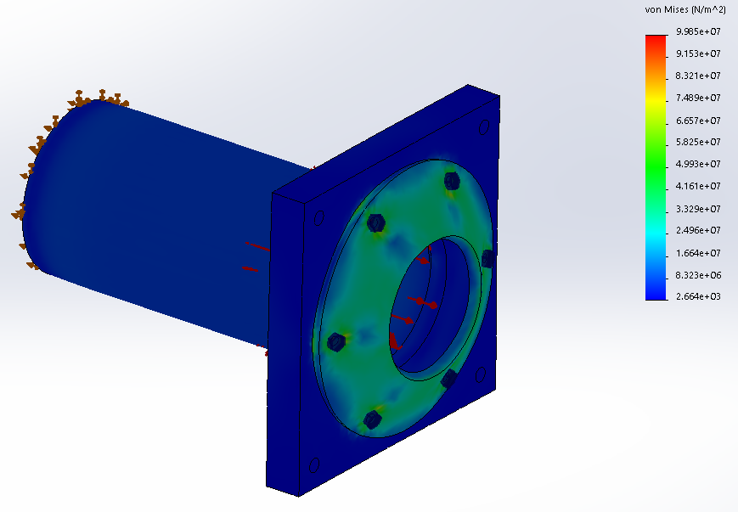
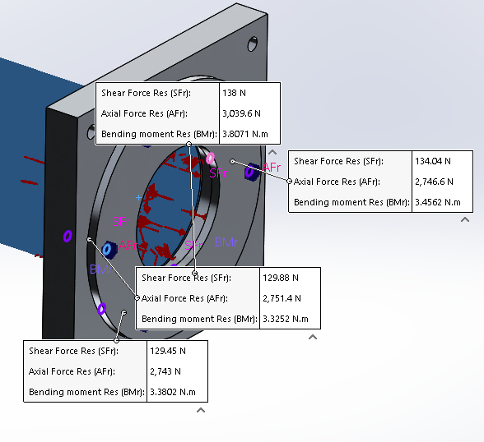
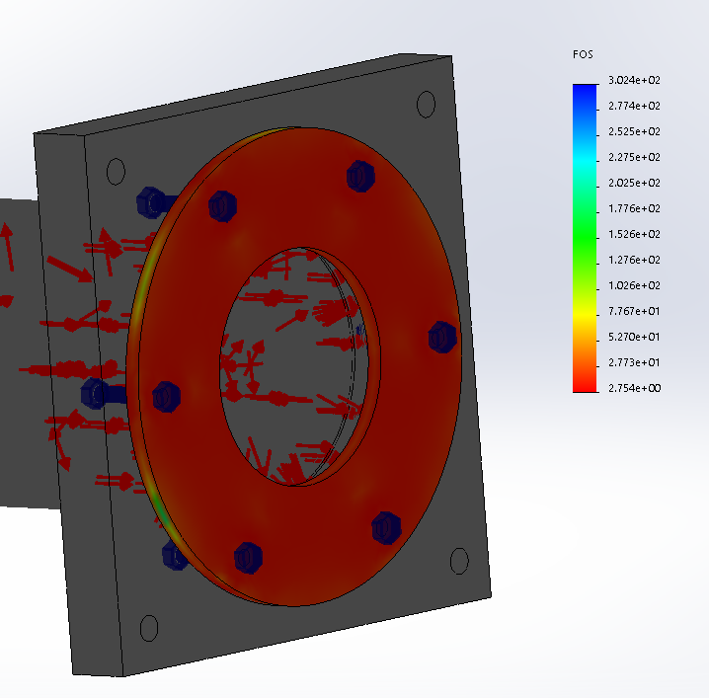
Combustion Chamber FEA
Pressure load: 150 psi
Bolt connection: 1/2-13
Mesh: element size 0.36 inch, # of elements 75000
Max σ_{von-mises} = 100 MPa
Axial force in bolts: 3 kN
Min FS = 2.75 at 150 psi

Slide 37
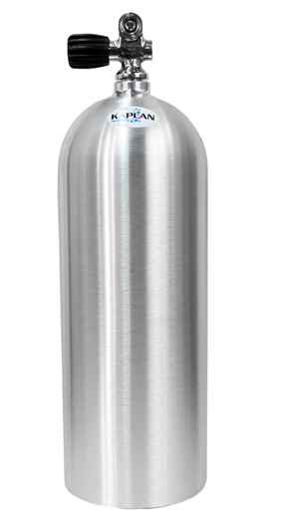
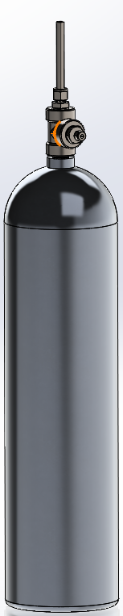
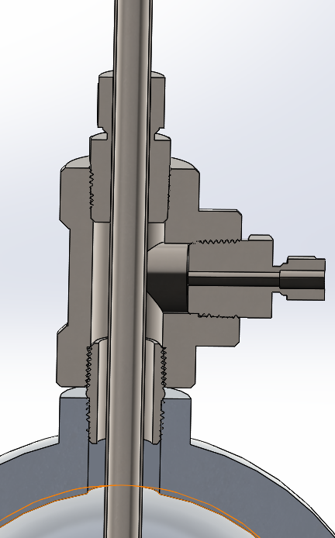
LOx Run Tank
LOX
Rated Working Pressure: 3000 psi
Tank Material: Al 6061 - T6
Tank Thread: 3/4 - 14 NPSM
Compatibility with LOX
According to NASA guidelines, Al 6061-T6 is compatible for LOX storage containers, but not piping
According to Air force test data at cryo LOX temperatures
Yield strength increases 120%
Dimensional area decreases 0.4% due to thermal contraction
An off the shelf load cell will be used for fill measurement
GN2

Slide 38
Main Injector - Material
Material: Inconel 718 (DMLS Printed)
Precipitation-hardening Nickel-Base superalloy
High strength in either annealed or aged condition
Highly oxidation resistant
Retains relatively high strength from cryo to over 1000 C
Poor machining characteristics
Offered by Protolabs and 3D systems
DMLS Limitations
Minimum feature size 0.38mm (0.015”)
Max overhang angle approx. 45°
Max horizontal circular cross section ⌀8mm

Slide 39
Main Injector - Interfaces & Envelope
Combustion Chamber: Radial seal - 2x size 240 O-rings (⅛” Cross Section)
Axially clamped by flange plate & tie rods
Radial seal needs less preload than face seal, and chamber wall will see small strain
Igniter: ½”-20 UNF thread with size 115 O-ring face seal
Easy to interchange igniter & injector designs
Avoids wear & leak paths of NPT fittings
O-ring gland can be printed into injector
Feed System: 2x 0.375” tube ends printed into injector
Use ⅜” Swagelok fittings to adapt or directly connect to main valves
Chamber Pressure Measurement (PTMC)
⅛” tube end printed into injector
Use Swagelok-¼” FNPT adapter to connect pressure transducer

Slide 40
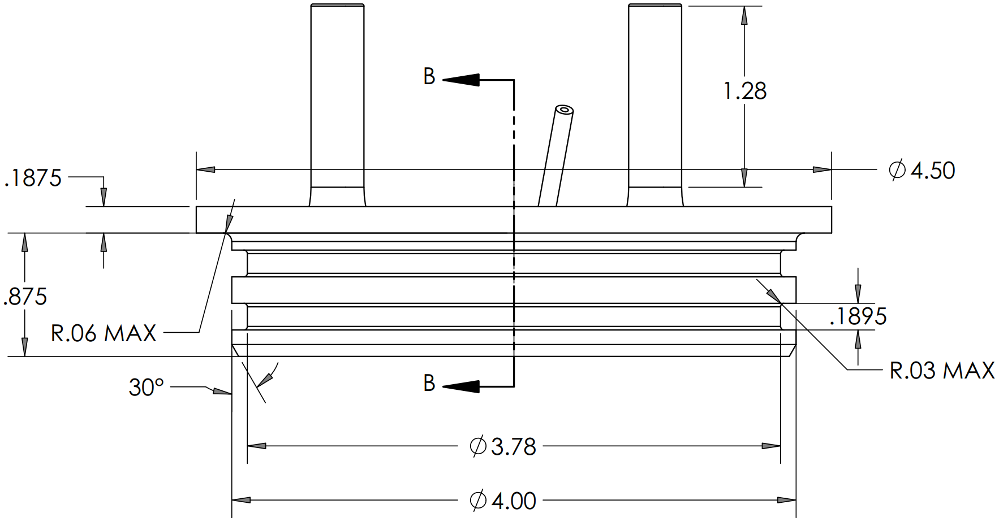
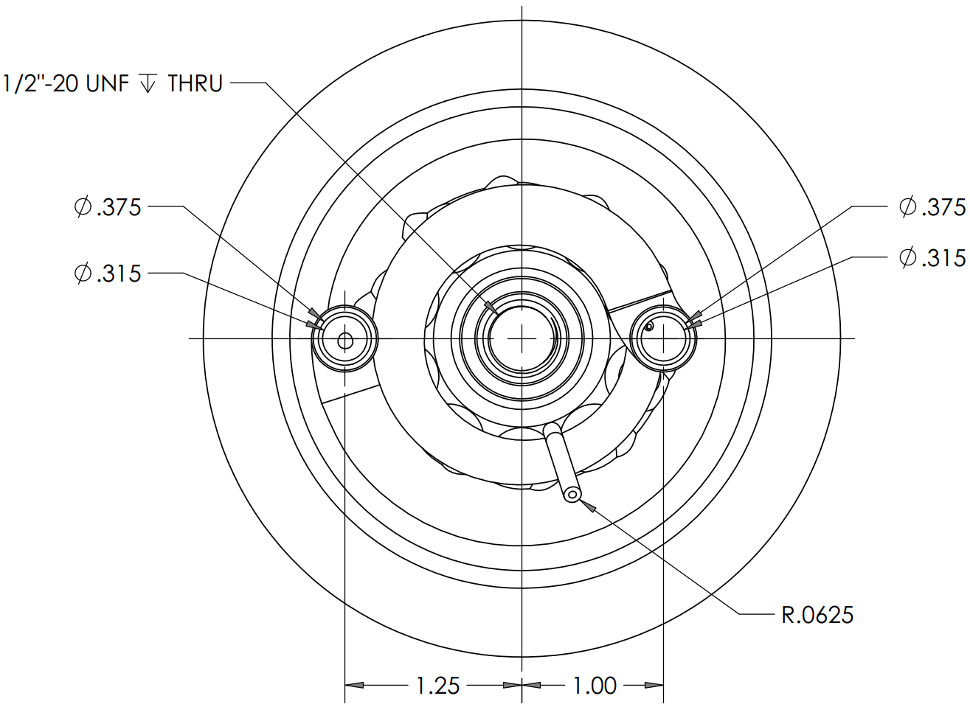
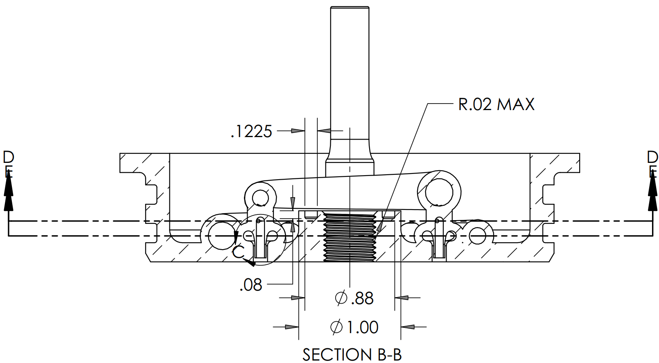
Main Injector - Interfaces & Envelope

Slide 41
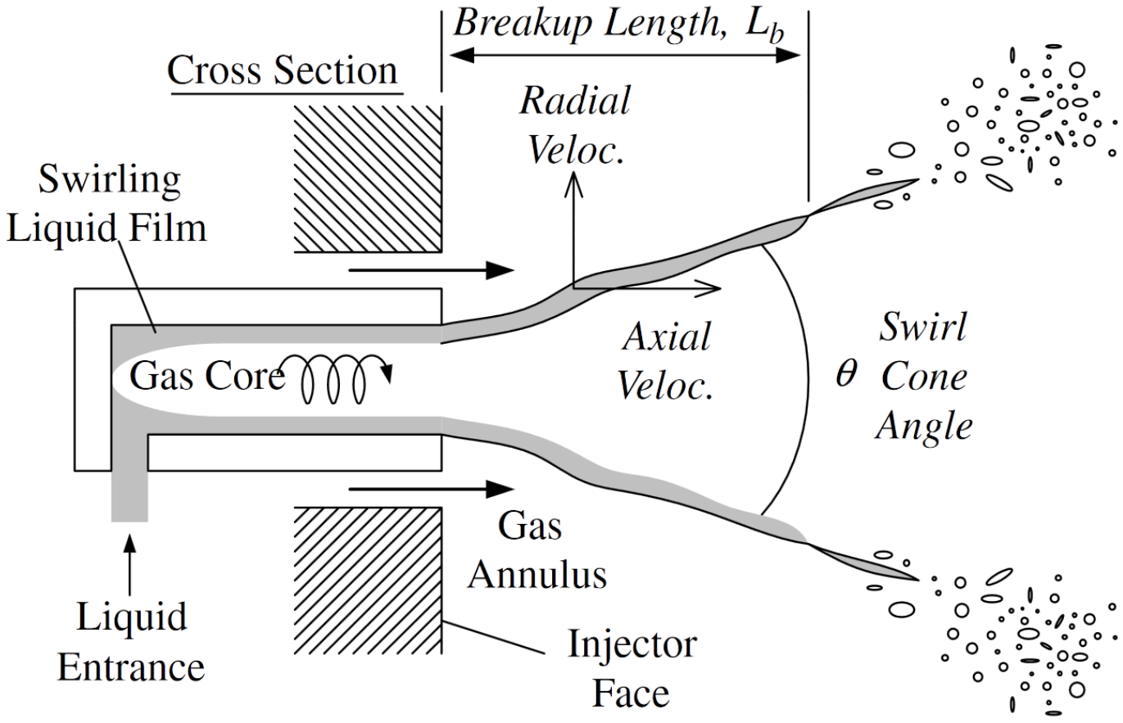
Main Injector - Elements
Liquid-Center Coaxial Swirl Elements
Gas impinges axially on liquid spray cone
Good mixing of unlike-phase propellants
Liquid-Liquid swirl used on many liquid-propellant engines
Element Sizing
Flow conditions at manifold inlet from simulation
Fuel: 24 bar, 240 K
LOx: 20 bar, 140 K
Target 10 bar outlet, Pc
10 elements nominally (arbitrary)
Fuel Orifice: 1.91E-5 m²
Assumed Cv 0.6, including manifolds (plate orifice)
LOx Orifice: 1.27E-5m²
Assumed Cv 0.9, including manifolds
Liquid-Center Coaxial Swirl Element [1]
[1] Im, Ji-Hyuk, et al. "Comparative study of spray characteristics of gas-centered and liquid-centered swirl coaxial injectors." Journal of Propulsion and Power 26.6 (2010): 1196-1204.

Slide 42
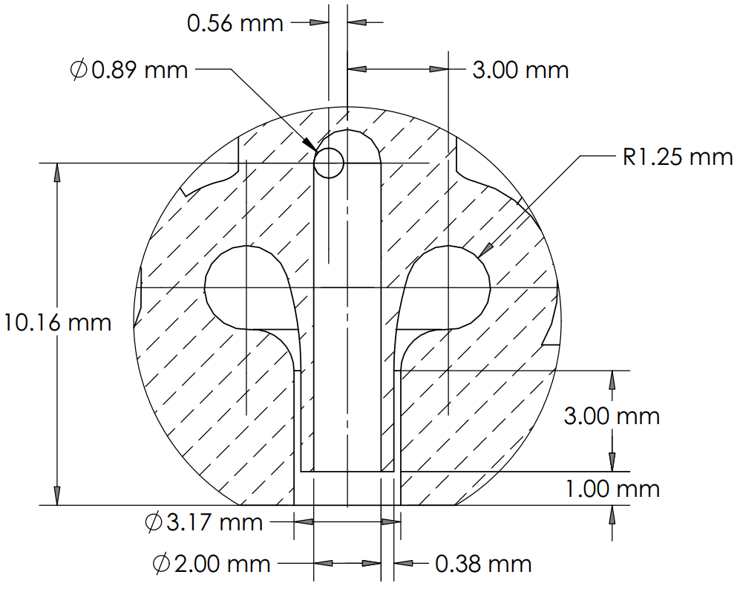
Main Injector - Elements
LOx Element
2x Tangential inlets ⌀0.89mm (net ⌀1.27mm)
“LOx Post” shared outlet ⌀2mm
Inlets tangent to outlet, ⟂ to outlet axis
Fuel Element:
Single annular orifice, ID 2.76mm, OD 3.17mm
Protolabs: min. wall thickness 0.381mm
⌀2.5mm toroidal manifold for annular orifice
Allow deceleration of gas before entering orifice to even flow distribution

Slide 43
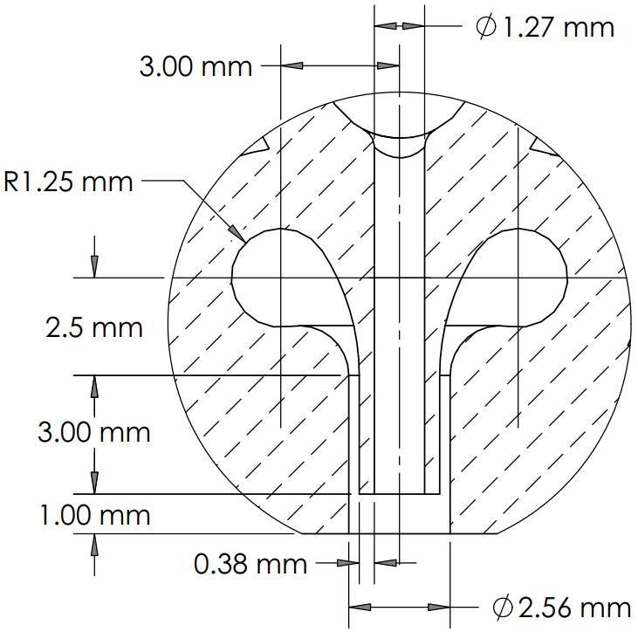
Main Injector - Elements (Alternative)
Coaxial Non-Swirl Element (Simpler to print)
LOx Element
Single ⌀1.27mm “post”
Direct inlet from LOx manifold
Fuel Element:
Single annular orifice, ID 2.03mm, OD 2.56mm
Protolabs: min. wall thickness 0.381mm
⌀2.5mm toroidal manifold for annular orifice
Allow deceleration of gas before entering orifice to even flow distribution

Slide 44



Main Injector - Element Performance Calcs
Estimates for coaxial non-swirl injector
CH4 exit area 1e-5 m²
Intact core length 4.6 cm
Spread angle 27.5 deg
To be updated once feed system pressure drops are better characterized

Slide 45
Main Injector - Manifolding
“Constant Velocity” Manifold Design
Constant rate of area change ⇒ Constant dynamic pressure (neglecting frictional losses)
As propellant is tapped off from manifold, manifold cross-section shrinks to maintain velocity
In constant-area manifold, dynamic pressure is converted to static as distance through manifold increases
Element inlets tap off perpendicular to manifold
Flow into elements is driven by static pressure
Maintaining static pressure evens out mass flow
Taper takes advantage of AM capabilities
Manifold Sizing
8mm max. unsupported circular cross-section ~2e-4 m²
Order of magnitude larger than orifice areas
Methane manifold velocity: ~120 m/s
Feed system sim code must be updated to include frictional losses
Liquid Oxygen manifold velocity: ~5.6 m/s

Slide 46

Main Injector - Manifolding
Green: Liquid Oxygen
Red: Methane
Tangential inlets for fuel elements are intended to even out mass flow around annulus, i.e. prevent higher mass flow near inlets

Slide 47

Main Injector - Manifolding
Green: Liquid Oxygen
Red: Methane

Slide 48

Main Injector - FEA
Thermal Analysis
All faces contacting LOx assigned 135 K
All faces contacting CH4 assigned 244 K
Chamber face & igniter body contacts assigned 500 K (arbitrary)
Static FEA
LOx & Fuel manifolds assigned 40 bar pressure
Chamber face & PTMC tap-off assigned 10 bar pressure (up to second O-ring gland on injector)
Supported with elastic supports on faces contacting chamber wall & retaining flange
Igniter attachment & fittings neglected
Thermal Analysis Results

Slide 49


Main Injector - FEA
Some surface yielding in fuel manifold, but no through-thickness yield
With slight refinement, design will certainly survive low-cycle fatigue from testing
Von Mises Stress Criterion
Factor of Safety (All regions with FSy < 1.5)

Slide 50


Igniter - Overview
Oxidizer | Gaseous Oxygen
Fuel | Gaseous Methane
Chamber Pressure | 13.8 bar (~200 psia)
Throat Diameter | 1/8 in
Chamber Diameter | 7 mm (spark plug thread ID)
O/F Ratio | 4.5
Ox Mass Flow Rate | 0.005 kg/s
Fuel Mass Flow Rate | 0.0011 kg.s
Chamber Temp | 3463 K
Material | Inconel 718
Safety Factor | >15
Chamber Length | 3 in
L* | 14.58
Contraction Ratio | 4.86

Slide 51



Igniter - Interfaces
Pressure transducer (attached via tube)
Out: threaded into center of injector, o-ring face seal
Possibly combined into a single component
In: ⅛” Swagelok tubing (with Lennox orifices matched to mass flow )
Ox Orifice | 1.76 mm
Fuel Orifice | 0.99 mm
Impinge angle | 120 degrees

Slide 52

Igniter - Spark Plug
NGK surface discharge spark plug
ACDelco ignition coil (7-24 Vdc)
ACDelco spark plug wire
Aptiv connectors

Slide 53


Igniter - FEA
Pressure: Safety Factor > 15
Temperature after 5 seconds
Heat transfer coeff of 500 W/m^2-K (needs to be refined)
Igniter will most likely run for much less than 5 seconds

Slide 54

Igniter - Engineering Drawing

Slide 55


Cavitating Venturi - Design Specifications
15 degree converging inlet
7 degree diverging outlet
Cp = 0.85
Cd = 0.95
d_th = 2.18 mm
Designed for DMLS from 3D systems

Slide 56

Cavitating Venturi - Engineering Drawings

Slide 57


Test Stand

Slide 58


Test Stand

Slide 59
Test Stand
Objective: Design as cheap and simple as possible for the designed loads
Material:
U-beams and L-beams from Home Depot, standard dimensions, plain steel
¼-28 bolts everywhere
Steel plate, 0.5 inch, easily weldable, total of 4 welds are needed on the support plate, another 12 small welds on the U-beams
No milling or CNC needed

Slide 60

Test Stand - FEA
Thrust loads analysis
Load applied: 2kN
8 bolts (¼-20, no pre-load)
Mesh: element size 0.4 inch, # of elements 15000
Max σ_{von-mises} = 89 MPa

Slide 61
Instrumentation & Control

Slide 62

Instrumentation
& Control
Diagram
Control
Power
Data

Slide 63





Control Component List
Power
24 VDC
9 VDC
5 VDC
Controller
Arduino Mega
Laptop
Data Collection
Micro SD breakout board
USB Repeater Cable
Emergency Stop
Big red button

Slide 64
Control System
Test sequence stored on Arduino Mega located on the test stand
USB extension cable allows serial communication to laptop with PySerial
Critical data (chamber pressure) plotted in real time
Test sequence initiation and other commands sent as character signals to arduino
Digital valve control commands sent from Arduino to opto-isolated relay block
Controls 24 VDC for valves and ignition coil
Mechanical emergency stop switch interrupts command line between arduino and relay block
Long extension cord (approx 300’) required for experimenters to access e-stop. Installing switch on the 24 VDC power line would result in high voltage drop
Oxygen run tank load cell monitored by Arduino

Slide 65


Test Operations - LOx Fill & Chill-in
LOx run tank and feed lines to be insulated by a 0.4 inch thick ceramic fiber insulation blanket and a two-layered aluminium polyethylene film
Fill procedure:
Measure empty run tank weight
Run LOx through the feed lines with the solenoid valve open (SVMO2)
Close SVMO2 when liquid flow is established through the feed
Keep fill valve (BVMO1) open until the weighing scale reads a 5 kg increase in the tank weight
Fill N2 through SVP until the pressure transducer reads 1100 psi

Slide 66
Test Operations - Pressurization and Hot-Fire
N2 gas pressurization system
Check valves to prevent backflow of gas into tank
Feed N2 to both LOx and CH4 tanks until required pressure is reached
Once the test starts, run N2 feed to maintain constant pressure
Hot-Fire test
Check valves are closed and in operation
Check pressurized tanks, ensure no leaks
Check data acquisition system
Push start button to begin test
Conduct a 2-second pre-run purge with N2 to purge impurities
Open LOx valve to begin oxidizer flow
Open the CH4 valves and start the igniter
Check the pressure of the combustion chamber, if safe, continue
Run test for 5s
Close valves and begin engine shutdown
Open LOx valve to cool the engine, then use CH4 valve to purge

Slide 67
Emergency Stop Capability
Shutdown button pressed if pressure readings exceed the maximum allowable values
Implemented by closing the LOx and CH4 supply and beginning the purge procedure
Following ASME protocol

Slide 68
Bill of Materials & Fabrication

Slide 69

BOM Spreadsheet
https://docs.google.com/spreadsheets/d/1Akb-G0P3gi-R2JIjckR0jrPFSVN0DPMDoXRMupv_SYY/edit#gid=676738434

Slide 70


Total Cost

Slide 71

Fabrication - Nozzle
Nozzle: graphite, conical converging-diverging with one O-ring groove
https://etmgraphite.com/
Long Beach, can ship to Stanford

Slide 72



Fabrication - Combustion Chamber
Aluminum tube: no grooves, easy to machine
PRL
Flange: square w/ circular center, 1” thick Al-6061, ½” deep slot for aluminum tube, O-ring groove in slot, 10 holes (4 tie rods, 6 bolts)
Likely too difficult for us to machine ourselves in PRL
Plate: circular w/ circular center, ¼” thick Al-6061, 6 bolt holes
PRL?

Slide 73

Fabrication - Main Injector
DMLS by 3D Systems or Protolabs
In discussion with both about sponsorship
Journal/Conference paper on project
If not, can likely purchase (~$1500)
Overhang Angle Analysis
Steepest exterior overhangs are on LOx manifold, ~55°, but are small enough area to print
O-ring glands on exterior can be supported & post-machined
Internal geometry stays below 4mm roof radius

Slide 74
Fabrication - Igniter
Iterative process:
Machine out of 316L stainless steel in PRL
Loop: test & redesign (if necessary)
DMLS for final design using Inconel 718
Sponsorship by 3D Systems or Protolabs
Stretch goal: incorporate into injector as a single component

Slide 75

Fabrication - Test Stand
All components can be bought with minimal lead time from Home Depot and McMaster
Small standard steel welding job
Estimated time to completion: 1 week
Only uncertainty: Mounting holes in parking lot are not useable anymore

Slide 76
Sourcing - Cryo Flow Controls
Ball Valves
Triad ¼” NPT ball valves
$399 with student discount
April 8th delivery date
Solenoid Relief Valves
Gems D-Cryo Series Solenoid Valve
$167
25 day lead time
Run Tank Scale
Parcel Scale from Ebay ($100)
Check Valves
Checkall ⅜” NPT check valve
$82.55
$42 extra for Oxygen cleaned
3 day lead
Cavitating Venturi
Printed with 3D systems
Lead time unknown

Slide 77
Sourcing - Lab Components Available at Stanford
Methane (main) | Tescom pressure regulator
 | 1/4 in Swagelok ball valve
 | MSP Pressure transducer (2)
 | 3/8 in Swagelok ball valve
LOx (main) | GP Pressure transducer (2)
Methane (igniter) | Victor regulator CGA 350 (Greg?)
 | Parker solenoid valve
 | MSP Pressure transducer
GOx (igniter) | Victor regulator CGA 540
 | MSP Pressure transducer
 | 1/4 in Swagelok ball valve
N2 (purge) | Victor regulator CGA 580
 | Parker solenoid valve (2)

Slide 78

Sourcing - Combustion Chamber Phenolic
Accurate Plastics
https://accurateplastics.acculam.com/item/c-ce-canvas-phenolic-laminates/phenolfab-trade-c-ce-laminate-tube/fbgt3-5004-000n

Slide 79
Sourcing - Fittings
https://docs.google.com/spreadsheets/d/1Akb-G0P3gi-R2JIjckR0jrPFSVN0DPMDoXRMupv_SYY/edit?usp=sharing
Sourced through McMaster-Carr and Swagelock
End decision will be made before purchasing based on price

Slide 80
Test Plan

Slide 81
Test Plan
Subsystem tests
Igniter test (needs to re-ignite for this mission)
Test igniter under operating conditions
Determine ignition timing, test control software, size of igniter throat
Series of tests
Ignite the igniter propellant in open air
Ignite in near vacuum under appropriate temperature conditions
Measure pressure rise in combustion chamber with no oxidizer flow
Hydro testing of pressure vessels
Manufacture components tested to 1.5 MAWP, holding pressure for 10 min
Fill test component with water
Procedure
Seal off pressure vessel except for a single entry port
Fill the vessel with deionized water
Orient the chamber to eliminate the presence of trapped air
Use a hydraulic pump cart to bring it up to a pre-determined test pressure
Hold pressure for an amount of time and visually inspect for leaks

Slide 82
Test Plan
Subsystem tests
Cold flow test
Confirm that oxidizer mass rate matches the design objective
Load rocket with oxidizer and vent, no igniter installed
Resize injector holes to tune oxidizer mass flow rate
Procedure
Setup air feed supply
Avionics startup, data acquisition, shutdown
Full system test
Single (5 second) burn
2 burns back-to-back
Three burns back-to-back

Slide 83
Backup Slides

Slide 84


LOx Tank - NASA Guidelines

Slide 85



LOx Tank - Airforce Data

Slide 86
LOx System Insulation
Details on insulator material & assembly method for run tank & feedline

